Slide 1
CP 224
LECTURE 03
Overview of Object-Oriented Data Modeling

Slide 2
Today’s Lecture
Object definition, Types and classes, Object methods
ODMG, Storage structure for complex/composite objects, Object identity
Encapsulation
Types/classes, Inheritance, late binding, Persistence.
Notes:
Object Database Management Group (ODMG)

Slide 3
Object Oriented DBMS
Database that stores data elements as objects. Uses object-oriented concepts.
The term object oriented is abbreviated by OO or O-O

Slide 4
Object Oriented DBMS
  #include <iostream>
  using namespace std;
  class home {
  private:
  double length;
  double breadth;
  double height;
  public:
  // function to initialize private variables
  void getData(double len, double brth, double hgt) {
  length = len;
  breadth = brth;
  height = hgt;
  }

Slide 5
Object Oriented DBMS
  double calArea() {
  return length * breadth;
  }
  double calVolume() {
  return length * breadth * height;
  }
  };

Slide 6
Object Oriented DBMS
  int main() {
  // create object of home1 class
  home home1;
  // pass the values of private variables as arguments
  home1.getData(42.5, 30.8, 19.2);
  cout << "Area of home = " << home1.calArea() << endl;
  cout << "Volume of home1 = " << home1.calVolume() << endl;
  return 0;
  }
Output
Area of home = 1309
Volume of home = 25132.8

Slide 7
Object
The entity that contains both attributes as well as the actions associated with it.
The object has two components
  State - values of property attributes
  Behavior - operation that modifies property attributes
Attributes can be classified into simple and complex

Slide 8
Object…
An object is described by following characteristics
  Identifier: a system-wide unique id for an object
  Name: an object may also have a unique name in DB
  Lifetime: determines if the object is persistent or transient

Slide 9
Object..
A simple attribute can be an integer, string, real and so on. Which takes on specific values.
A complex attribute can contain collection and/or references.
A reference attribute represent a relationship between objects and contain a value or values.

Slide 10
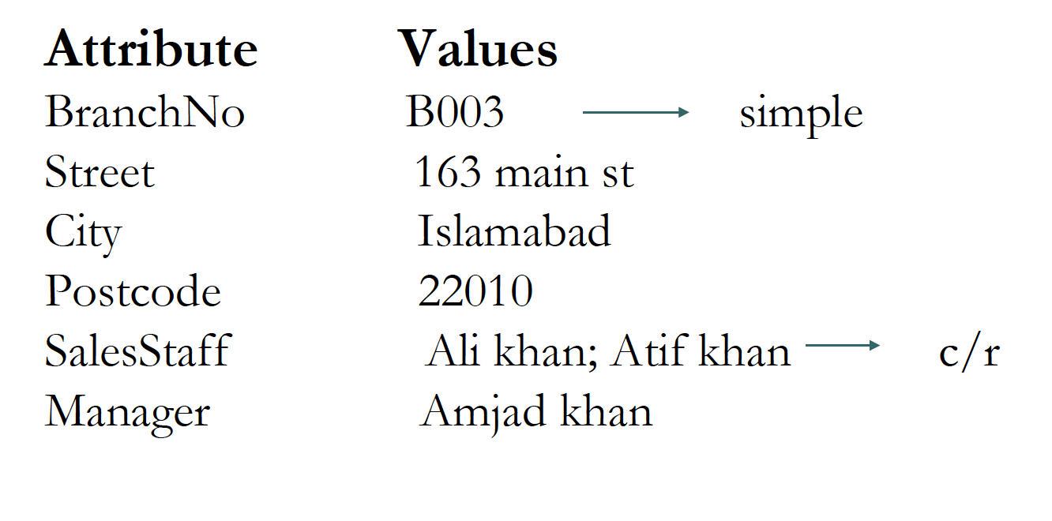
Example
Object attributes for branch instance

Slide 11
Example…
BranchNo is example of simple attribute with value B003
The attribute Salesstaff is collection of staff objects.
Salestaff is example of reference attribute.
The reference attribute is similar to foreign key in the relational DBMS.

Slide 12
Features of OO
1.Object Identity
An OO database provides a unique identity to each independent object stored in the database.
This unique identity is implemented via a unique system generated object identifier OID.
The value of OID is not visible to the user but it is used internally by the system to identify each object uniquely.

Slide 13
Features of OO
The main property required of an OID is that it be immutable that is the OID value of a particular object should not change.
It is also desirable that each OID be used only once, that is even the object is removed from the database its OID should not be assigned to another object.
OID cannot be modified by the user.

Slide 14
Features of OO
2.Abstraction
Abstraction is the process of identifying the essential aspects of an entity and ignoring the unimportant properties.
There are two fundamental aspects of abstraction
  Encapsulation
  Information hiding

Slide 15
Encapsulation
The concept of encapsulation means that an object contains both data structure and the set of operations that can be used to manipulate it.
Example
        Define class Employee:
        type tuple( name: string;
        birthdate: date;
        salary: float; );
        operations create-emp: employee;
        destroy-emp: boolean;
        End employee;
Notes:
Encapsulation uses five types of modifier to encapsulate data.
Public
Private
Protected
Internal
Protected internal

Slide 16
Information hiding
The concept of information hiding is that we separate the external aspects of an object from its internal details.
The internal details are hidden from the user.
So that the internal details can be changed without affecting the application that use it, that is the external details remain the same.
User only knows available methods and how to call them.

Slide 17
Information hiding
3.Methods and Messages
In object technology functions are usually called methods.
Methods define the behavior of the object.
They can be used to change the object’s state by modifying its attribute values
A method consist of a name and a body that perform the action associated with method name

Slide 18
Example
method void updatesalary(float increment)
{
Salary=salary+increment
}
It is a method use to update a member of
staff’s salary.

Slide 19
Example Cont…
Messages
  Messages are the means by which objects communicate. A message is simply a request from one object to another asking the object to execute one of its methods.
Example
Staffobject.updatesalary(100)
4.Classes
Classes are used to define a set of similar objects.
  Objects having same attributes and respond to same messages can be grouped together to form a class.

Slide 20
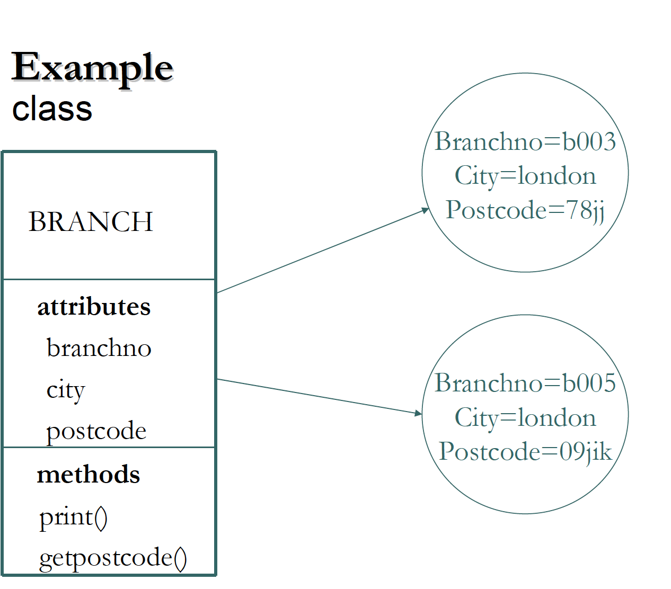

Slide 21
Subclasses, Superclasses and inheritance
Some objects may have similar but not identical attributes and methods. If there is a large degree of similarity, it would be useful to be able to share the common properties.
Inheritance allows one class to be defined as a special case of a more general class.
These special cases are known as subclasses and the more general cases are known as superclasses.

Slide 22
Subclasses, Superclasses and inheritance Cont…
There are several forms of inheritance
Single inheritance
Multiple inheritance
Repeated inheritance
Selective inheritance
Single inheritance:
  Single inheritance refers to the fact that the subclasses inherit from no more than one superclass.

Slide 23
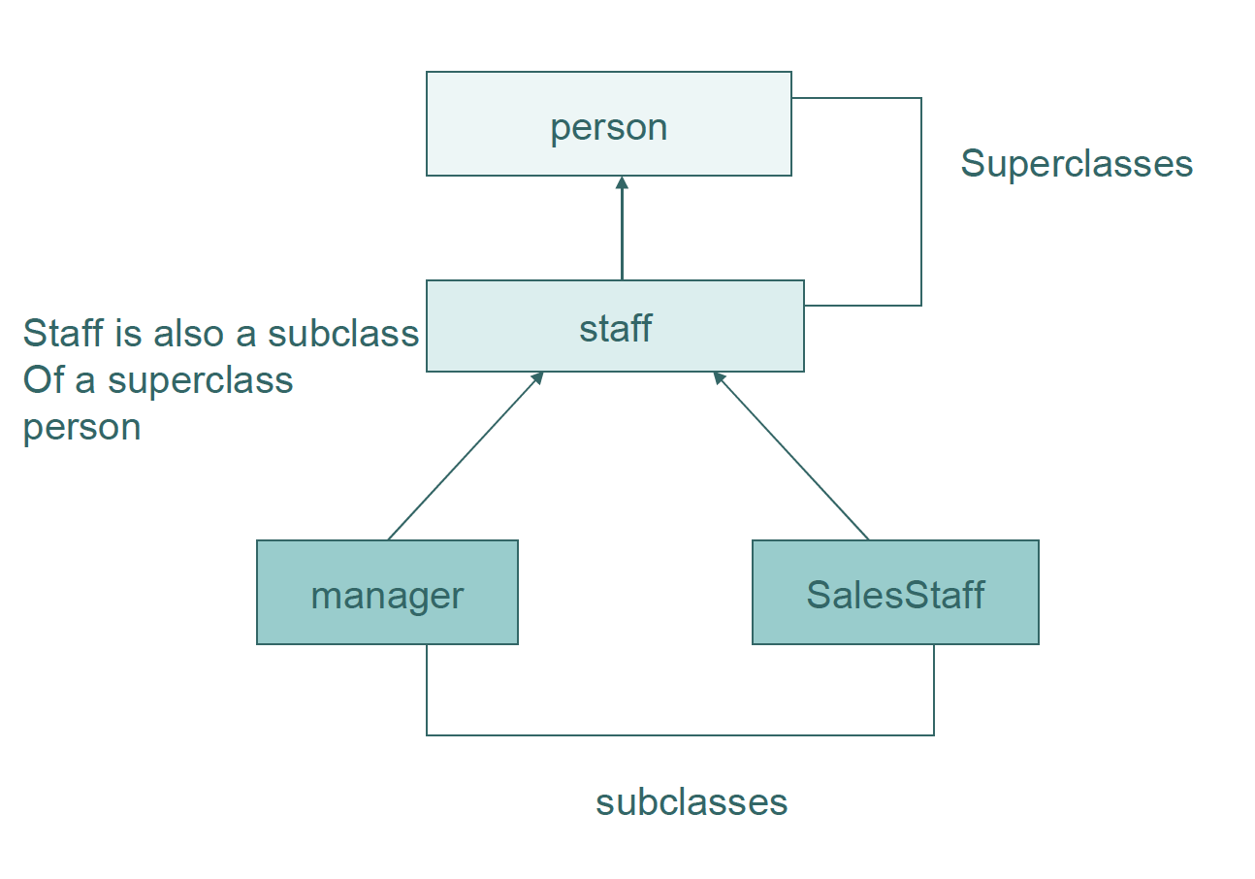
Example

Slide 24
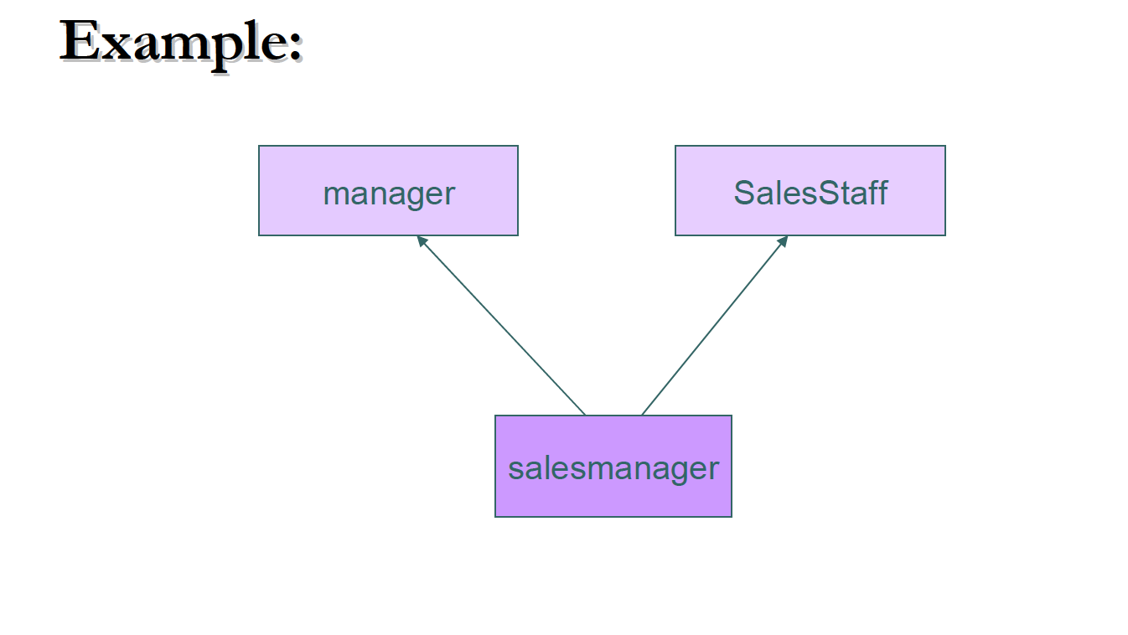
Multiple inheritance
Multiple inheritance refer that the subclass inherit from more than one superclasses.

Slide 25
Subclasses, Superclasses and inheritance Cont…
The multiple inheritance is very problematic . The conflict arises when the superclasses contain the same attributes or method.
It can be handled by the following ways:
  Include both attributes/method and use the name of the superclass as qualifier.
For example if “bonus” is attribute of both manager and SalesStaff the subclass salesmanager can inherit bonus from both, and qualify bonus in salesmanager as either manager.bonus or SalesStaff.bonus

Slide 26
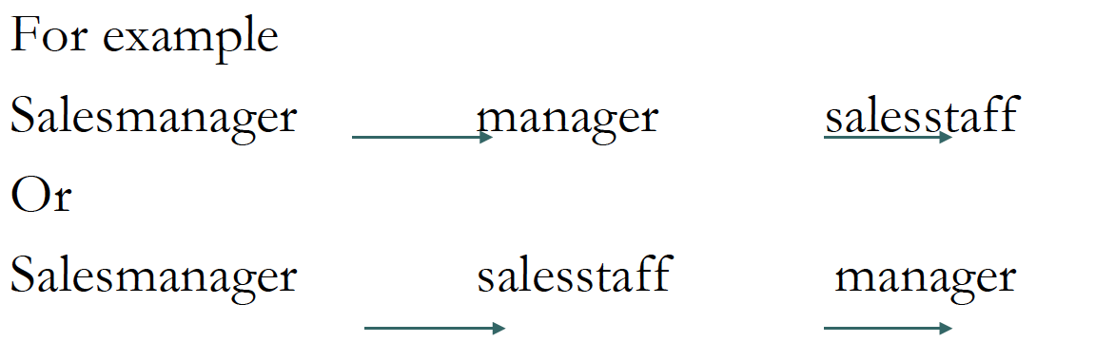
Subclasses, Superclasses and inheritance Cont..
Use single inheritance to avoid conflict

Slide 27
Repeated inheritance
It is a special case of multiple inheritance in which the superclasses inherit from a common superclass.
The inheritance mechanism must ensure that the subclass does not inherit properties from the superclass twice.

Slide 28
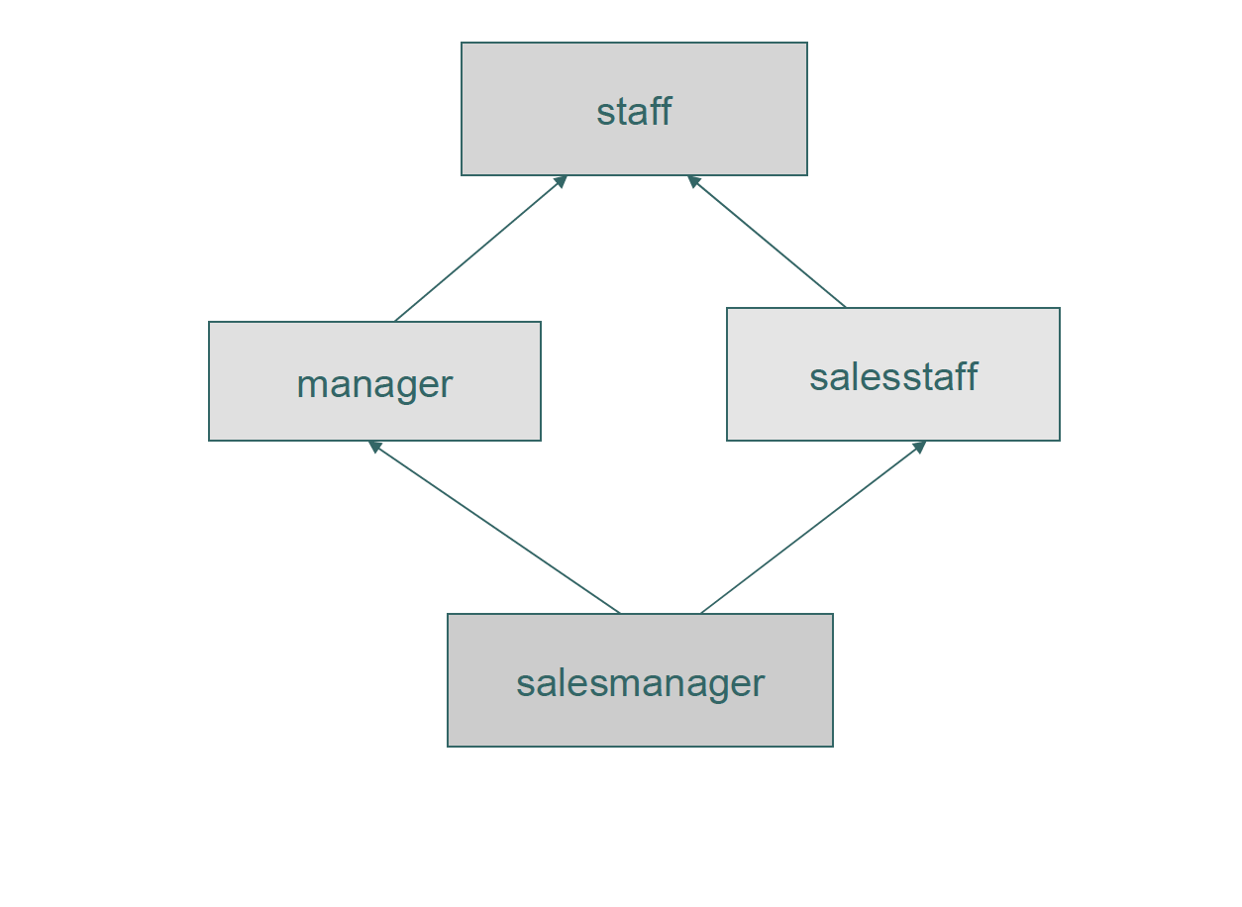
Example

Slide 29
Selective inheritance
It allows a subclass to inherit a limited number of properties from the superclass.

Slide 30
Overriding and Overloading
Properties are automatically inherited by subclasses from their superclasses.
However it is possible to redefine a property in the subclass. This process is called overriding.

Slide 31
Overriding and Overloading
For example we might define a method in the staff class to increment salary
  Method void givecommission(float profit)
  {
  Salary=salary+0.02*profit;
  }
However we may wish to perform a different calculation for commission in manager subclass, we can do this by redefing the overriding
    Method void givecommission(float profit)
    {
    salary=salary+0.05*profit;
    }

Slide 32
Overriding and Overloading Cont…
Overloading allows the name of a method to be reused within a class definition.
  This means that a single message can perform different functions depending on which object receive it.
For example:
  Overloading print method for branch object and staff object

Slide 33
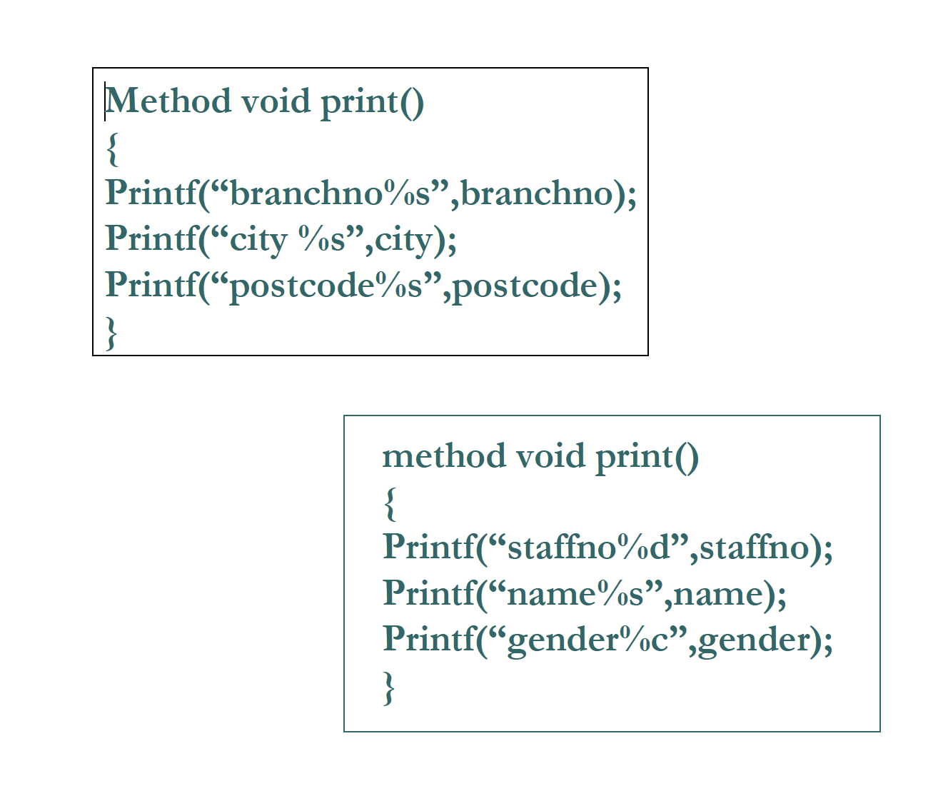

Slide 34
Object Oriented Database Management
Object Oriented databases have evolved along two different paths:
Persistent Object Oriented Programming Languages: (pure ODBMSs)
  Start with an OO language (e.g., C++, Java, SMALLTALK) which has a rich type system
  Add persistence to the objects in programming language where persistent objects stored in databases
Object Relational Database Management Systems (SQL3 Systems)
  Extend relational DBMSs with the rich type system and user-defined functions.
  Provide a convenient path for users of relational DBMSs to migrate to OO technology
  All major vendors (e.g., Informix, Oracle) will/are supporting features of SQL3.

Slide 35
Object Database Management Group (ODMG)
Special interest group to develop standards that allow ODBMS customers to write portable applications
Standards include:
  Object Model
  Object Specification Languages
    Object Definition Language (ODL) for schema definition
    Object Interchange Format (OIF) to exchange objects between databases
  Object Query Language
    declarative language to query and update database objects
  Language Bindings (C++, Java, Smalltalk)
    Object manipulation language
    Mechanisms to invoke OQL from other languages
    Procedures for operation on databases and transactions

Slide 36
Storing Objects in a Relational Database
Mapping classes to relations
  There are number of strategies for mapping classes to a relations but each result in a loss of semantic information.
Map each class to a relation
  One approach is to map each class to a relation. With this approach we lose the semantic information of which class is superclass and which one is subclass.

Slide 37
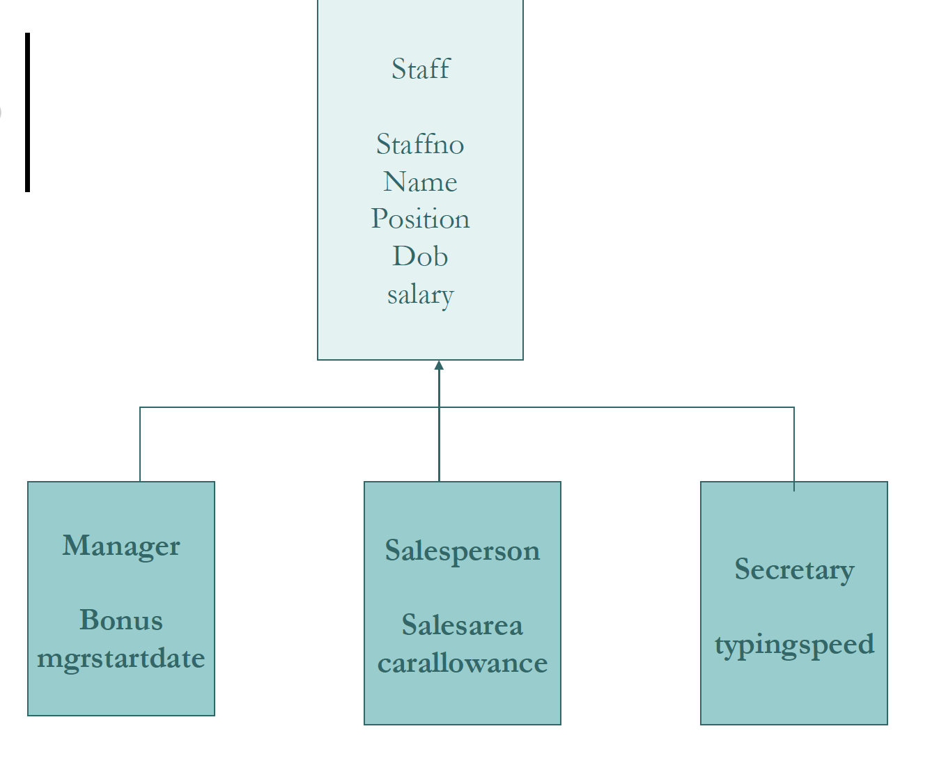

Slide 38
Storing Objects in a Relational Database Cont..
  Staff(staffno,name,position,dob,salary)
  Manager(staffno,bonus,mgrstartdate)
  Salesperson(staffno,salesarea,carallowence)
  Secretary(staffno,typingspeed)
Map each subclass to a relation
  A second approach is to map each subclass to a relation.
  In this approach we lost semantic information , it is no longer clear that the relations are subclasses.

Slide 39
Storing Objects in a Relational Database Cont…
  Manager(staffno, name, dob, position, salary, bonus, mgr_startdate)
  Salesperson(staffno, name, dob, position, salary, sales_area, car_allowence)
  Secretary(staffno, name, dob, position, salary, typingspeed)
Map the hierarchy to a single relation
  The third approach is to map the entire hierarchy to a relation.
  Again we lost some semantic information and it will produce an unwanted number of nulls for attributes that do not apply to the tuple.

Slide 40
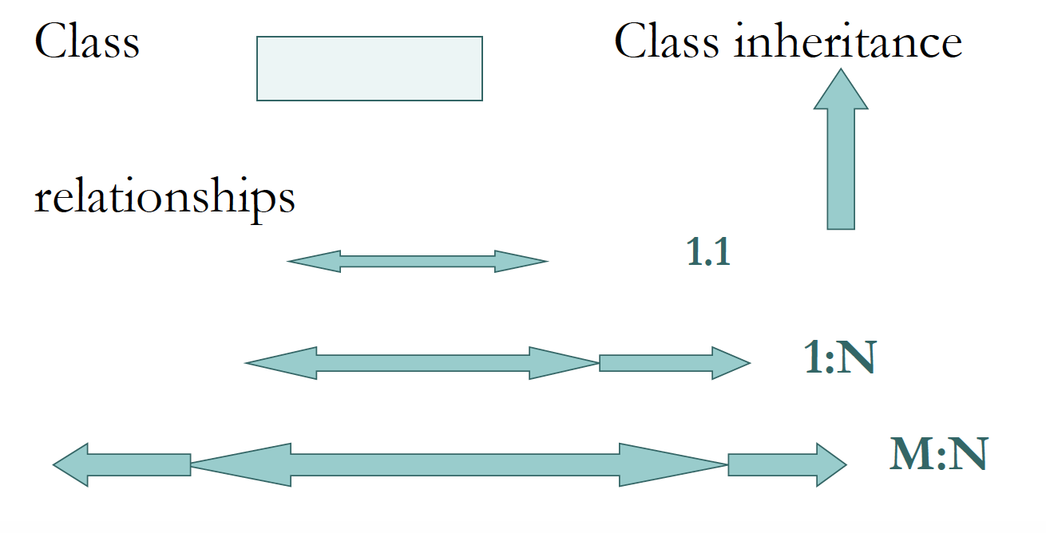
Object definition language(ODL)
The ODL is designed to create an object database schema.

Slide 41
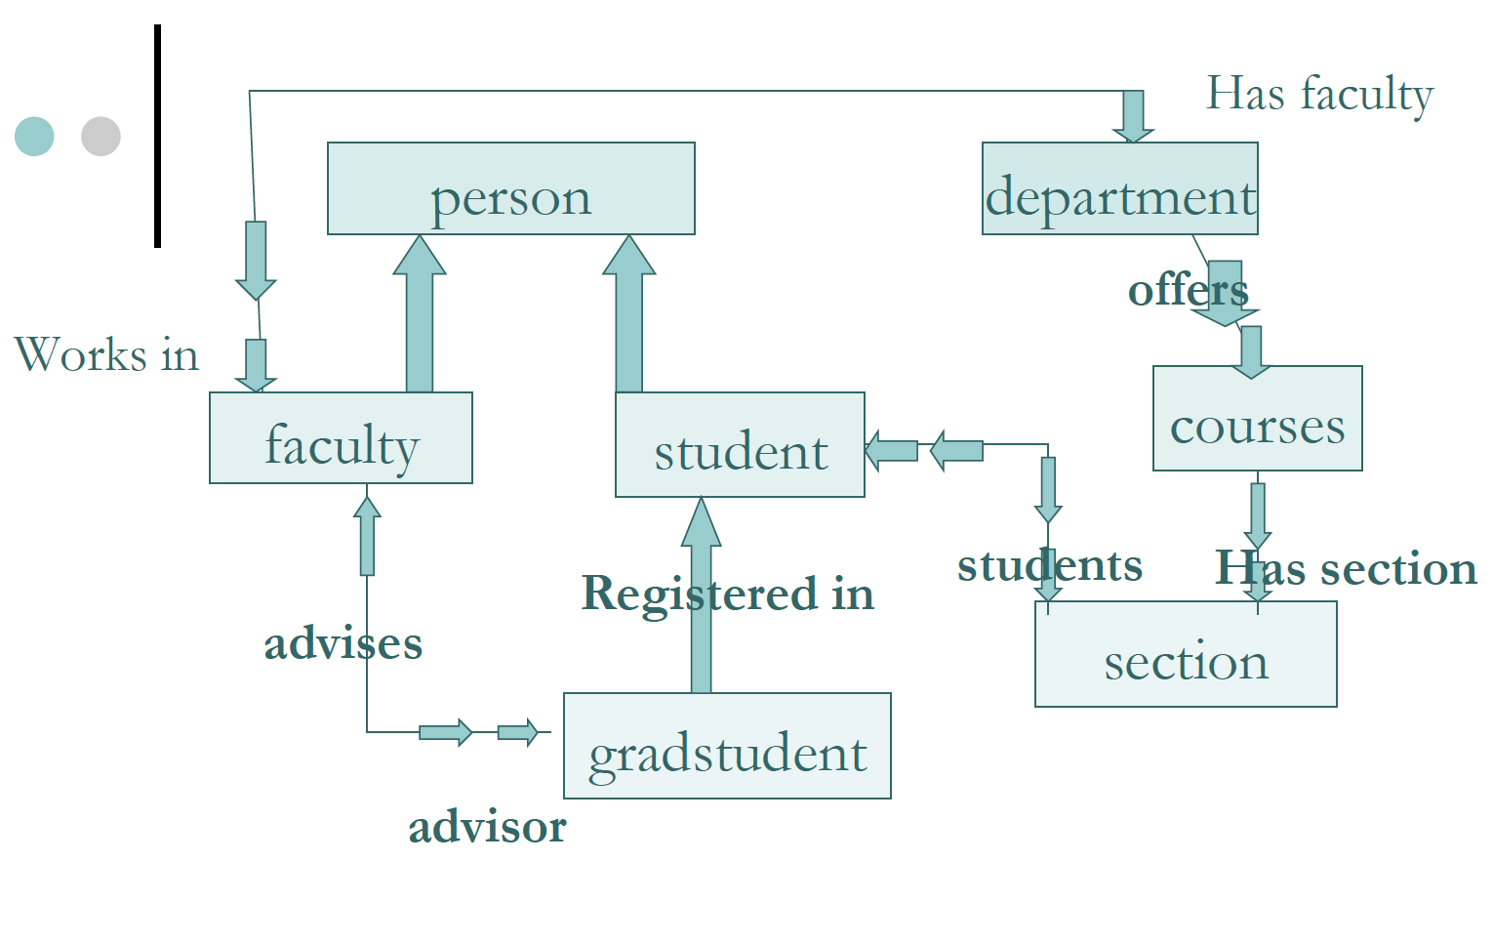

Slide 42
END!!!!

